Slide 1
Chemical Kinetics
The Study of Reaction Rates

Slide 2
What is a Rate?
The rate of a process in the amount of progress that has been made, divided by the time required to achieve that progress.
Speed = $\frac{∆distance}{∆time}$
Example: You travel 102 miles in 2.00 hours
Average Speed = $\frac{102 mi}{2.00 hr}$ = 51.0$\frac{mi}{hr}$

Slide 3
The Rate of a Chemical Reaction
In a chemical reaction, we can define “progress” as the consumption of a reactant or the formation of a product.
To measure this progress, we measure how much a reactant concentration decreases in a given period of time, or how much a product concentration increases in a given period of time.

Slide 4
The Rate of a Chemical Reaction
But not everything in a chemical reaction is changing at the same rate.
2A(g) + 3B(g) → C(g) + 4D(g)
Suppose the concentration of substance A is decreasing at the rate of 0.40 mol/ L s. What is happening to the other concentrations?

Slide 5
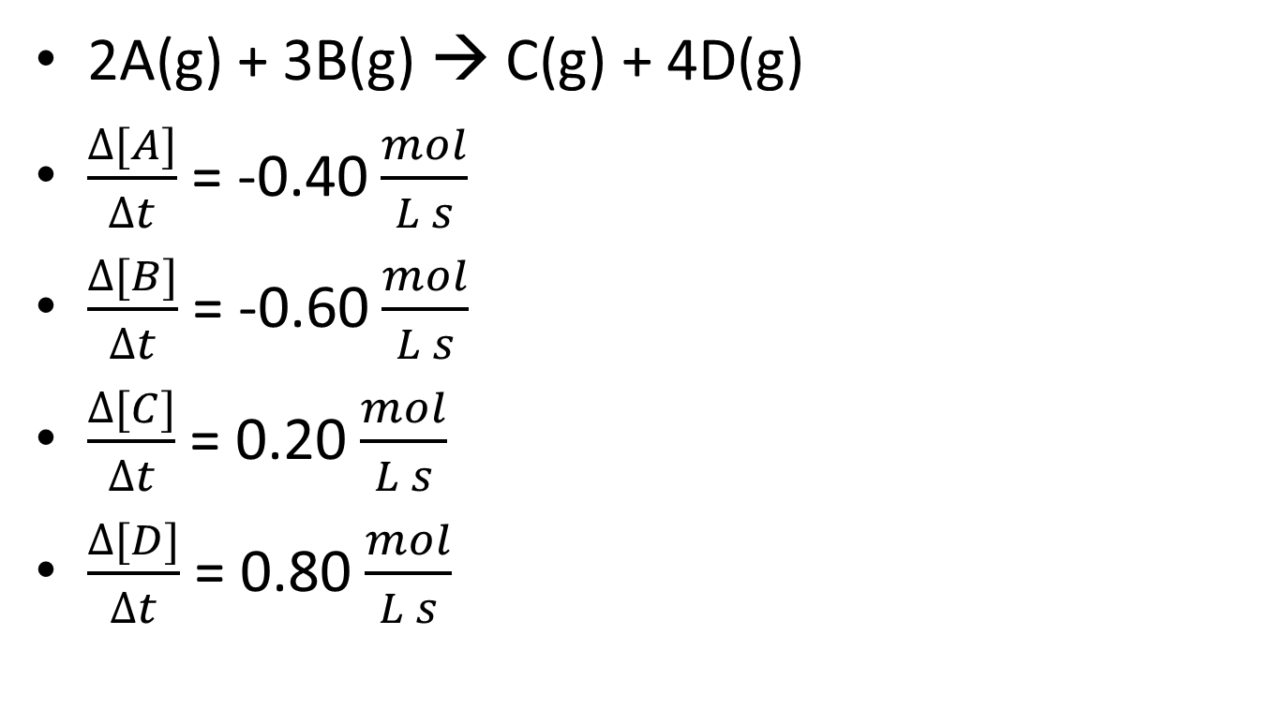
The Rate of a Chemical Reaction
2A(g) + 3B(g) → C(g) + 4D(g)
$\frac{∆[A]}{∆t}$ = -0.40 $\frac{mol}{L s}$
$\frac{∆[B]}{∆t}$ = -0.60 $\frac{mol}{L s}$
$\frac{∆[C]}{∆t}$ = 0.20 $\frac{mol}{L s}$
$\frac{∆[D]}{∆t}$ = 0.80 $\frac{mol}{L s}$

Slide 6
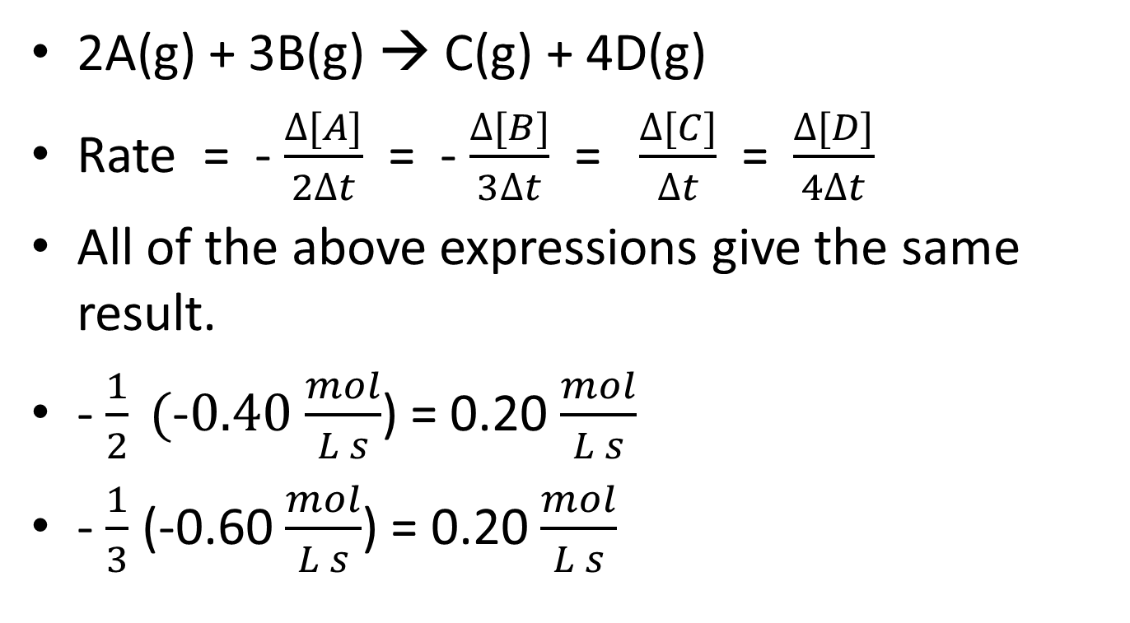
Standardizing the Rate of a Chemical Reaction
2A(g) + 3B(g) → C(g) + 4D(g)
Rate = - $\frac{∆[A]}{2∆t}$ = - $\frac{∆[B]}{3∆t}$ = $\frac{∆[C]}{∆t}$ = $\frac{∆[D]}{4∆t}$
All of the above expressions give the same result.
- $\frac{1}{2} (\text{-}0.40$ $\frac{mol}{L s}$) = 0.20 $\frac{mol}{L s}$
- $\frac{1}{3}$ (-0.60 $\frac{mol}{L s}$) = 0.20 $\frac{mol}{L s}$

Slide 7
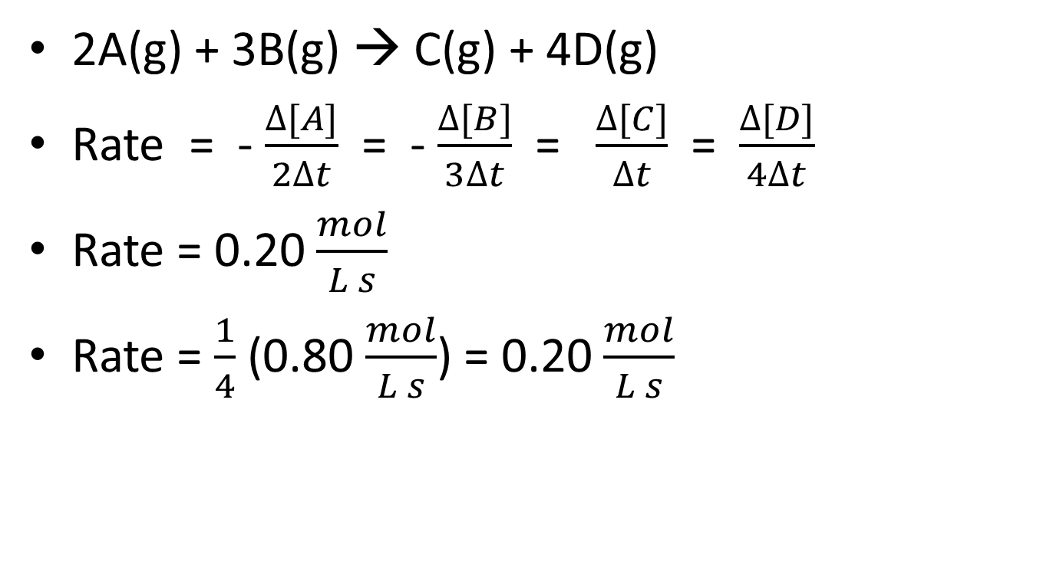
Standardizing the Rate of a Chemical Reaction
2A(g) + 3B(g) → C(g) + 4D(g)
Rate = - $\frac{∆[A]}{2∆t}$ = - $\frac{∆[B]}{3∆t}$ = $\frac{∆[C]}{∆t}$ = $\frac{∆[D]}{4∆t}$
Rate = 0.20 $\frac{mol}{L s}$
Rate = $\frac{1}{4}$ (0.80 $\frac{mol}{L s}$) = 0.20 $\frac{mol}{L s}$

Slide 8
Reaction Rate from Concentration Measurements
TIME (Seconds) | [H₂O₂]
0 | 0.882
60 | 0.697
120 | 0.566
180 | 0.458
240 | 0.372
300 | 0.298
360 | 0.236
420 | 0.188
480 | 0.152
540 | 0.120
600 | 0.094

